Slide 1
Making Custom Dataset using Auto-labeling
Preparing a custom dataset in PASCAL VOC format for the EDGE Computing
course project using an auto-labeling technique to avoid manually labeling every image.
github: https://github.com/bxod/edge_dataset_make

Slide 2
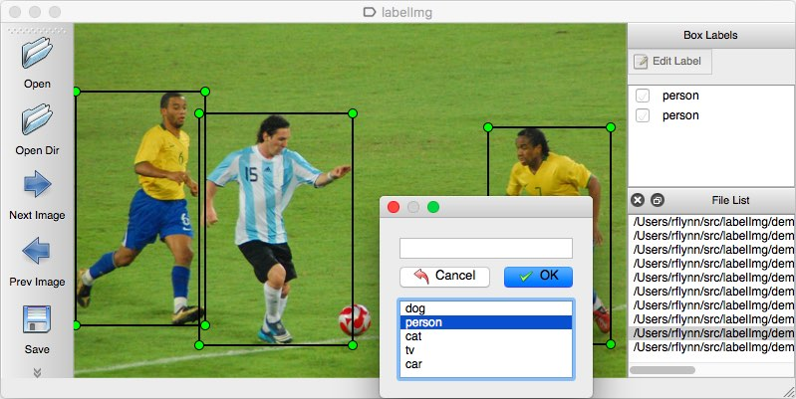
The problem
We have previously seen labeling the images and creating an XML file manually
However, for robust model training we need thousands of images for each class
Manual labeling of thousand of images takes huge amount of time

Slide 3
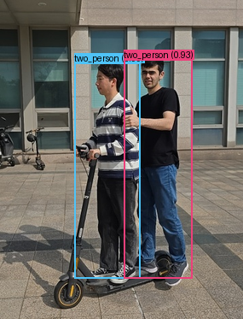
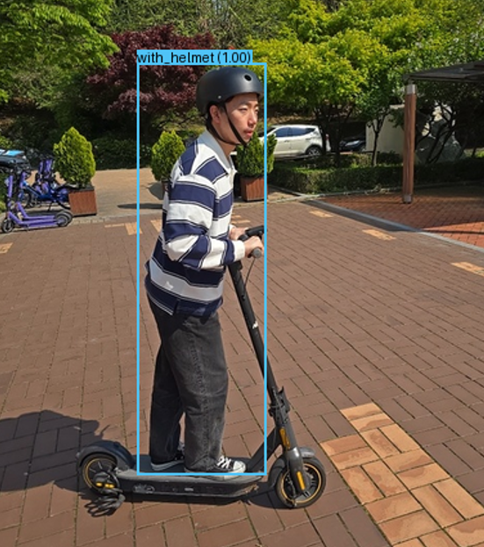
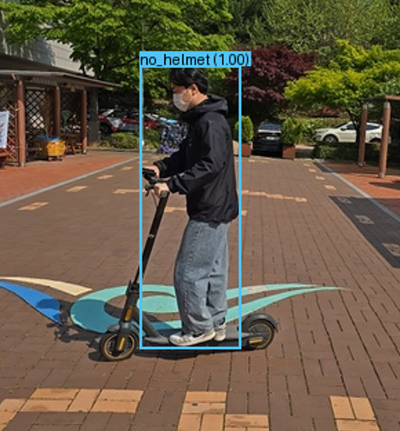
Dataset Classes
For this project, we built a dataset with the following classes:
no_helmet: a kick scooter rider without a helmet
with_helmet: a kick scooter rider wearing a helmet
two_person: two persons riding the same kick scooter
This presentation covers the following steps:
1. Collecting and formatting images
2. Shuffling and renaming the images
3. Auto-labeling and creating XML files using YoloV8 model

Slide 4

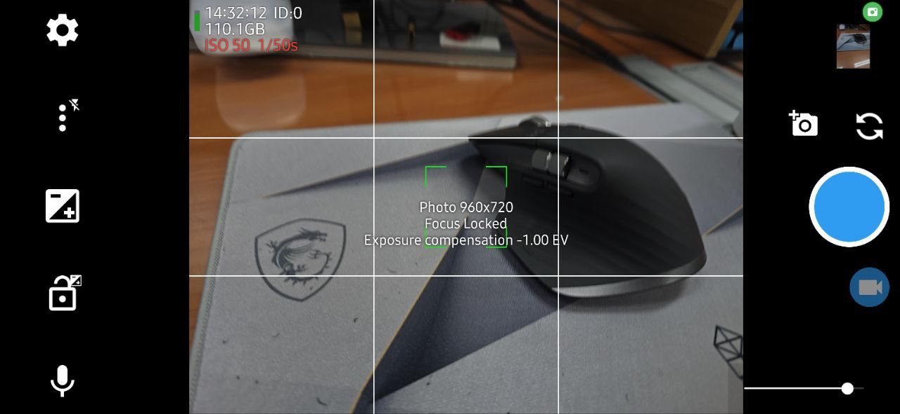
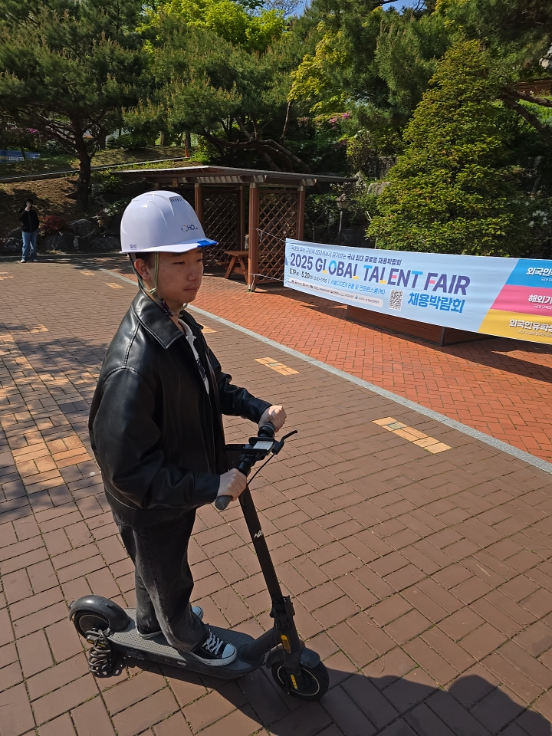
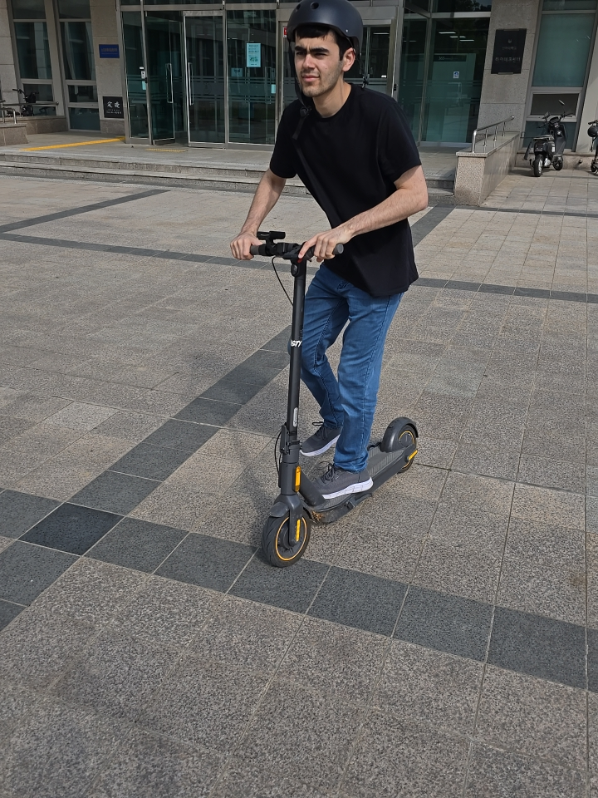
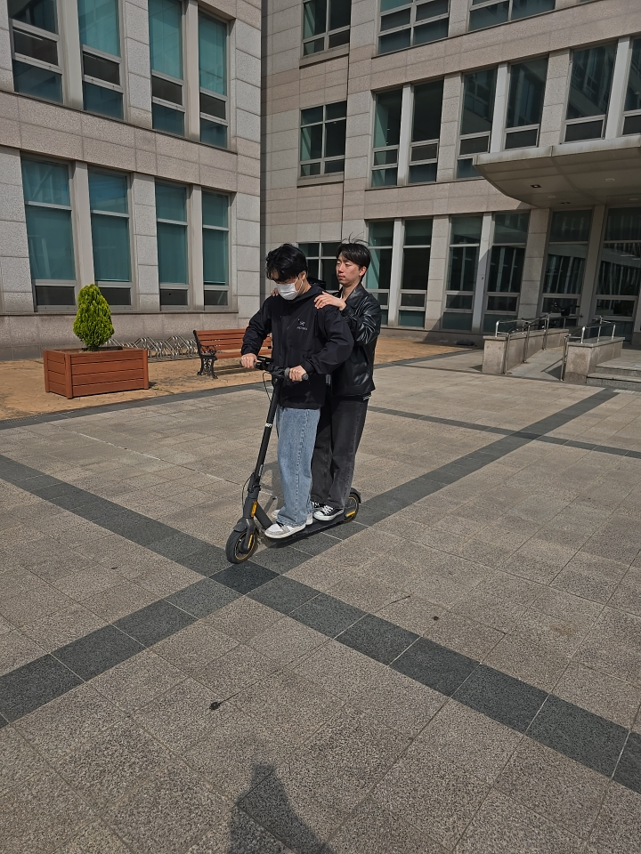
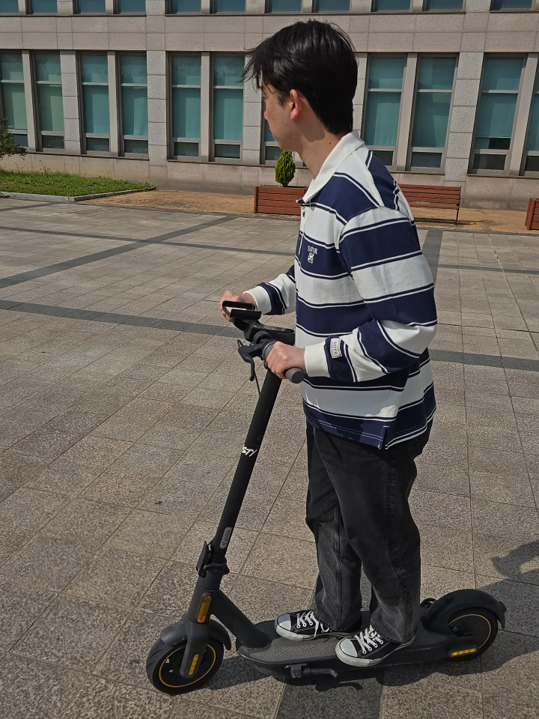
Data preparation
We captured images with the resolution in the range: 512x512 and 1080x1080 resolution in JPG format using our mobile phone.
Preferrably, capture images in landscape mode (width>height)
We used the “Open Camera” Android app to capture images at 960×720 resolution.
We captured over 3,000 images across the three classes, ensuring varied backgrounds and clothing for model robustness.

Slide 5
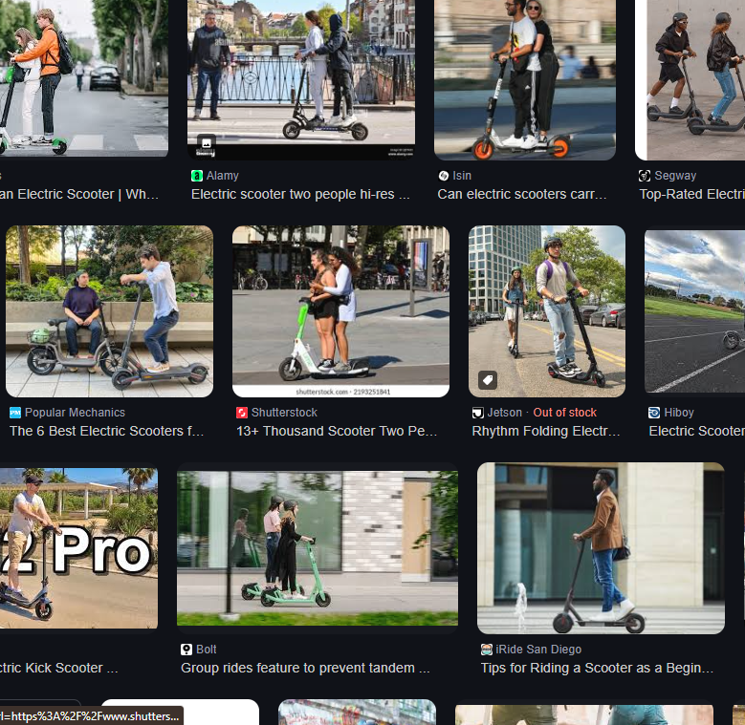
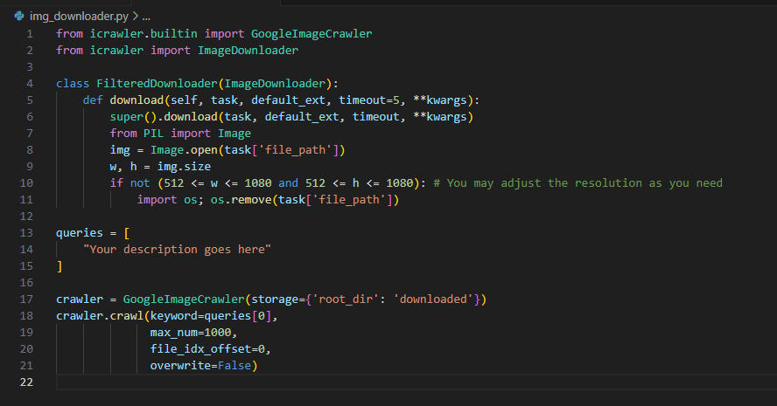
Data preparation
We downloaded an additional 400 images in total from Google for three classes using img_downloader.py (available at github)
The code allows us to download images with the given description.
We can also set the width and height of the images that we want. In our case it was >512 and <1080

Slide 6
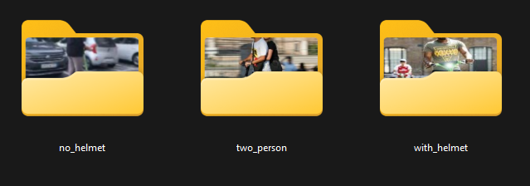
Folder organization
We now have around 3,500 images for three classes.
We placed all raw images in three separate folders under the dataset root:
dataset_root/
├── no_helmet/ (1,034 images)
├── with_helmet/ (1,615 images)
└── two_person/ (762 images)
Ensure all images are in .jpg format and within the 512×512 to 1080×1080 pixel range to match the SSDLite320–640 input requirements.

Slide 7
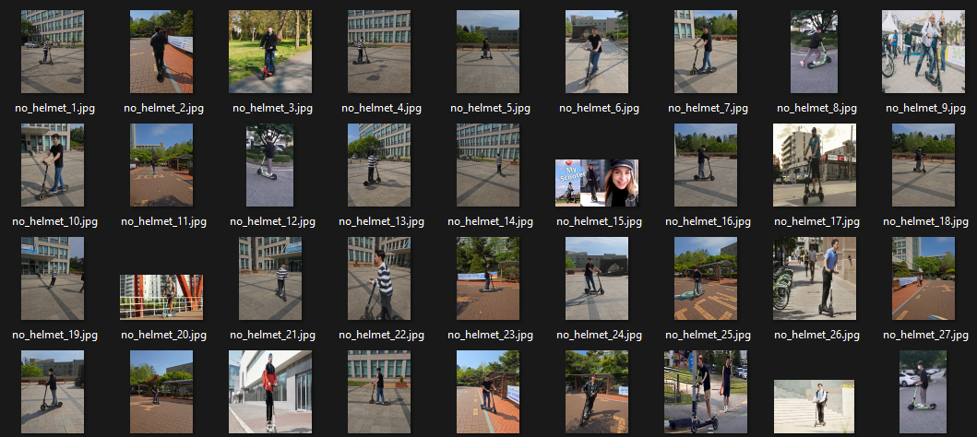
Shuffling and Renaming
We wrote custom code shuffler.py to randomly shuffle images within each class folder and rename them as {class_name}_{order}.jpg
By shuffling the images randomly, we prevent overfit and make the model more robust for different environments
Run:
python shuffler.py
# Will rename images inside the given folder. E.g. inside
# with_helmet folder, each image will be renamed as:
# with_helmet_1.jpg,
# with_helmet_2.jpg, ...

Slide 8
Auto-Labeling
Auto-labeling of the images and assigning XML files.
Install the following packages:
pip install ultralytics
pip install pillow
Make sure you have CUDA available if you are going to use GPU for auto detecting objects
python -c "import torch; print(torch.cuda.is_available())"
Create XML files
We wrote custom xml_maker.py to create XML labels for each class folder. For a dataset root ./dataset_root, the code will iterate through the images inside each class folder, and create xml file for each image and assign the classname as the name of the container folder.

Slide 9
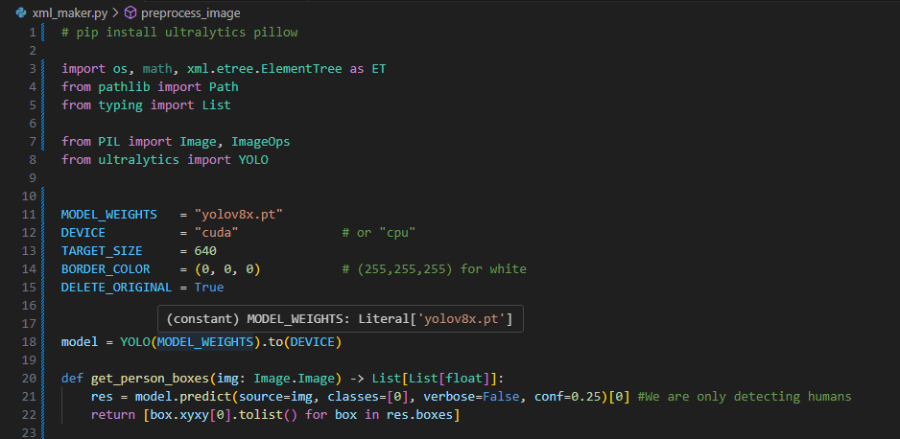
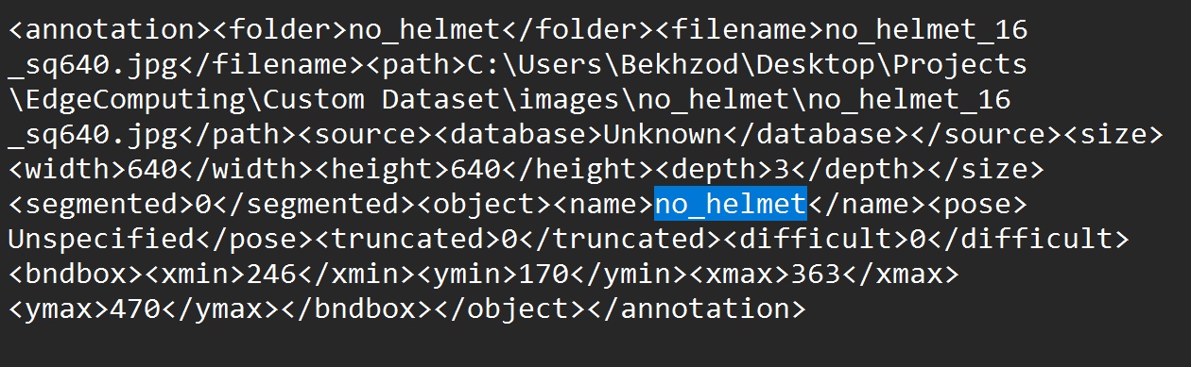
xml_maker.py
There are lack of models that detect classes no_helmet, with_helmet, two_person for kick-scooter riders.
So, we have to only detect humans in each class folder and label that image with the folder name
E.g., XML files inside the /with_helmet folder will be given the class /with_helmet along with the position of the humans inside the corresponding image
We now have XML label files created next to each image file. We now split the dataset into train, test, validation subfolders according to PASCAL VOC format.
In our case, we splitted with the ratio 8:1:1 for train, test, validation respectively.
- Train (2772 images)
- Validation (321 images)
- Test (321 images)
XML file compatible with PASCAL VOC training code

Slide 10
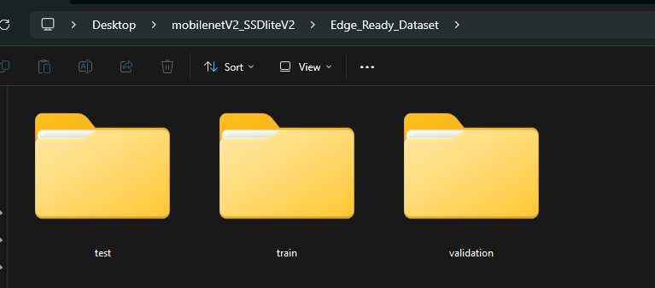
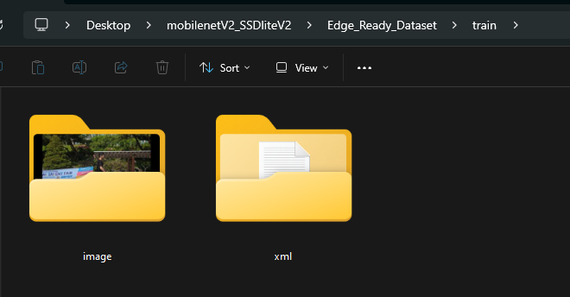
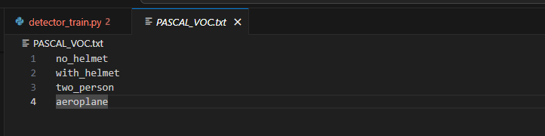
Final steps
Our final dataset folder looks like this:
parent folder
train folder
We can now place the parent folder inside our PASCAL VOC trainer project and change the PASCAL_VOC.txt file to include our dataset classes.

Slide 11
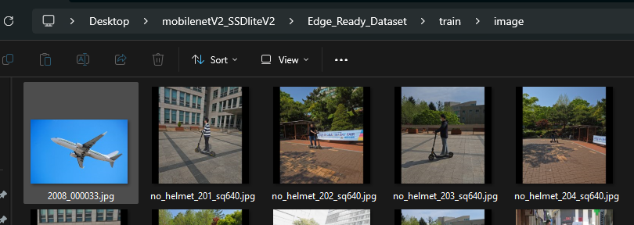
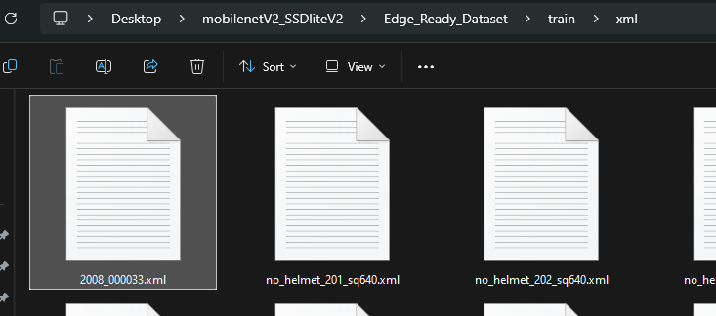
Notes
The trainer project does NOT allow less than 4 classes. So if our dataset contains three classes, we should create a dummy 4th class with one image and its xml file in train, test, validation folder. It will not affect other classes.
In our case, we selected an airplane image from PASCAL VOC dataset with its xml file and placed it inside Train, Test, Validation folders.

Slide 12
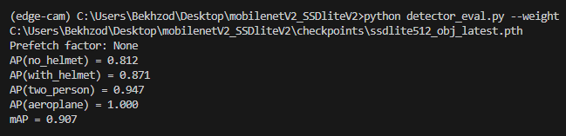
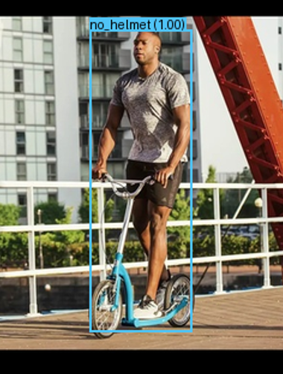
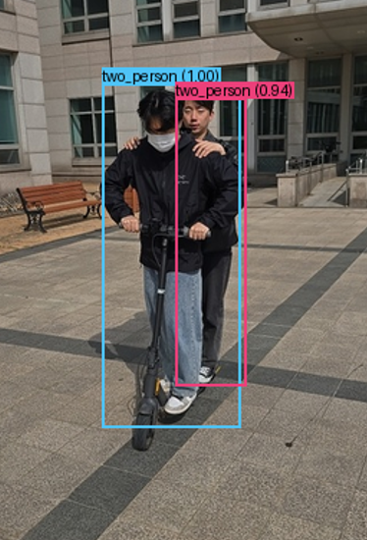
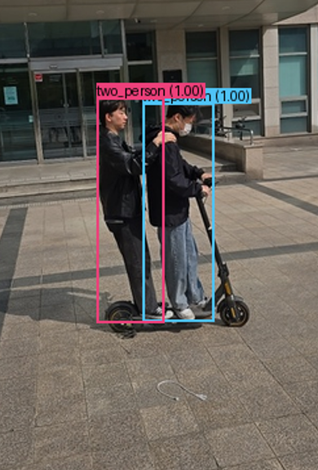
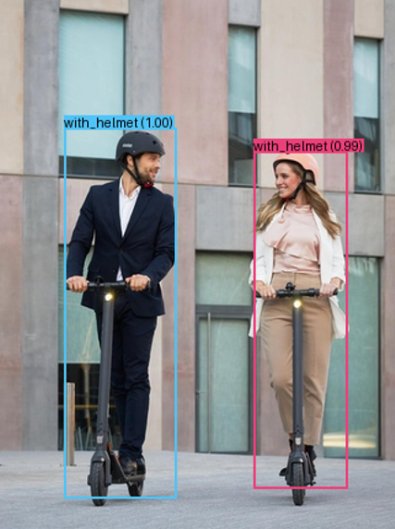
Inference Results
Detection results on Test dataset
We achieved over 80% Average Precision for all 3 classes on unseen Test data.

Slide 13
Github
github: https://github.com/bxod/edge_dataset_make

